Slide 1
Recommender Systems
Presented By: Seyed Erfan Nourbakhsh
Master: Dr.Kiani
Fall 2022

Slide 2
Contents
Introduction
Filtering methods and algorithms
Approaches of implementing recommender systems
Content-based filtering recommender systems
Collaborative filtering recommender systems
Evaluation of recommender systems
Implementation of the recommender system

Slide 3

Introduction
Recommender systems capture the pattern of people’s behavior and use it to predict what else they might want or like.

Slide 4







Applications
What to buy?
E-commerce, Books, Movies, Shops, …
Where to eat?
Which job to apply to?
Who you should be friends with?
LinkedIn, Facebook, …
Personalize your experience on the web
News platforms, News personalization

Slide 5
Some company's achievements by using recommender systems
According to the statistics provided by MacKenzie Scott, 35% of the purchases made from the Amazon retail website were as a result of using the recommender system.
Recommendation systems are the main reason for 70% of people who watch videos on YouTube.
According to statistics provided by MacKenzie Scott, 75% of what people watch on Netflix is based on the recommendations of the system's recommender.
According to the statistics provided by DigiMag, During the last year, the use of the smart recommendation system in Digikala has grown by 30%.
….

Slide 6
Method of providing data
Explicit ranking
It is done by the users
recommender system extracts the user's opinion directly
Types of ratings:
Star rating
Review
Feedback
Like
Following
Implicit ranking
When users interact with items
The recommender system infers user behavior
Types of ratings:
Clicks
Views
Purchases

Slide 7
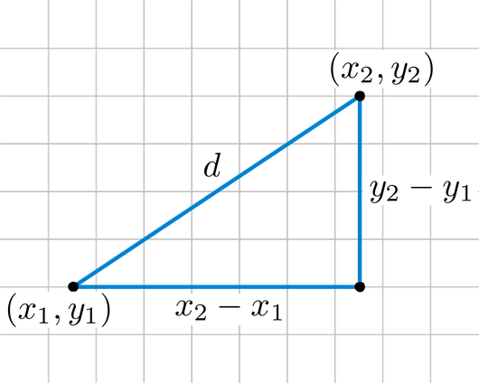
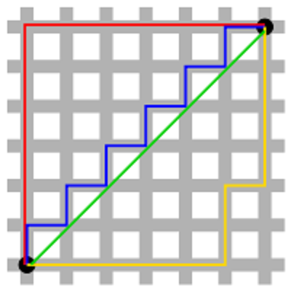
Some similarity measurements
Similarity measures are distance measures. The closest points to each other are the most similar to each other and the farthest points are the least similar to each other.
Minkowski Distance
Manhattan Distance
Euclidean Distance
Hamming Distance
Cosine Similarity
Pearson Coefficient
Jaccard Index

Slide 8
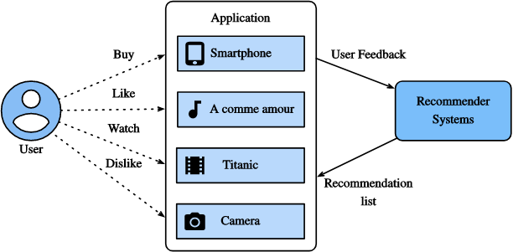
Advantages of recommender systems
Broader exposure to many different products that might be interested in
Possibility of continual usage or purchase of products
Provides better experience (increase potential revenue & better security for customers)
Send emails that contain links to suggested items based on the user's preferences
Gaining the trust of customers

Slide 9
Filtering methods and algorithms

Slide 10
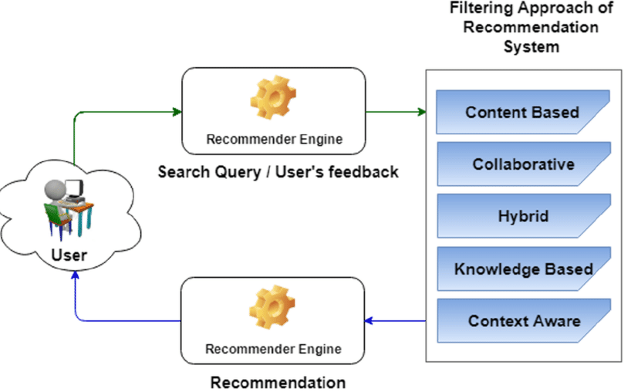
Filtering methods and algorithms
Collaborative filtering
Demographic filtering
Content-based filtering
Social-based filtering
Context-aware filtering
Location-aware recommendation systems
Knowledge-based filtering
Bio-inspired algorithm

Slide 11
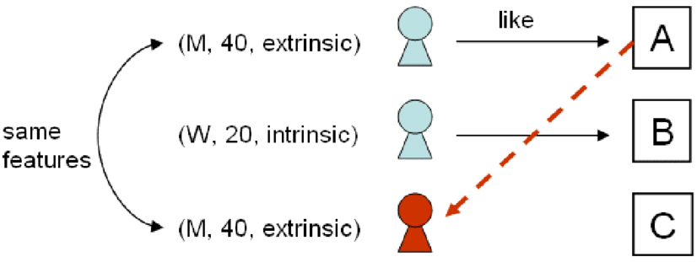
Demographic Filtering
Information such as age, gender, nationality, etc. are included in the demographic information group
Users who have similar demographic characteristics (for example, fall in the same age range) probably have similar tastes and desires.

Slide 12
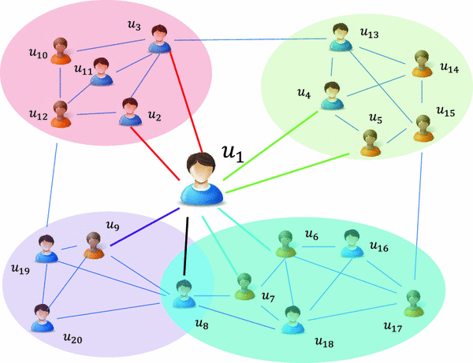
Social-based Filtering
Using the information available in these networks (such as trust, followed, followers, friends, comments, blog and tags) in recommender systems
Improving the proposed results as well as reducing the sparsity problem
Two types of scientific studies and research in social-based filtering:
Improving the efficiency of existing systems
Creating a new recommender system based on Social Filtering (use the potential in such networks to create an independent system)

Slide 13
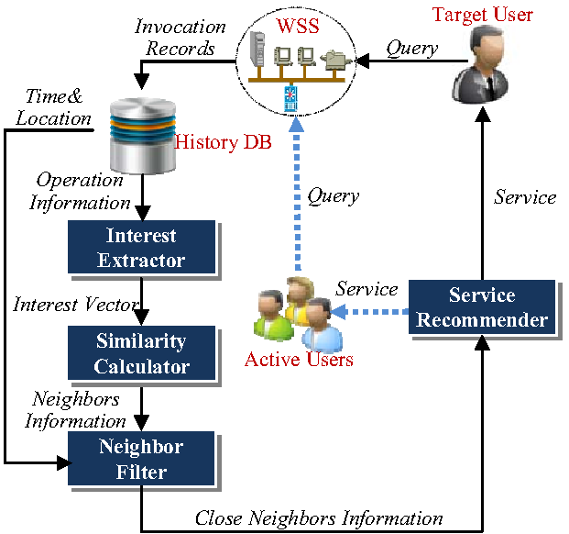
Context-aware Filtering
There are various devices and sensors that collect information about the user's context.
The emphasis of these systems is on information such as time, location, information from security cameras, RFIDs and wireless sensor networks, as well as health parameters, shopping and eating habits of a person.

Slide 14
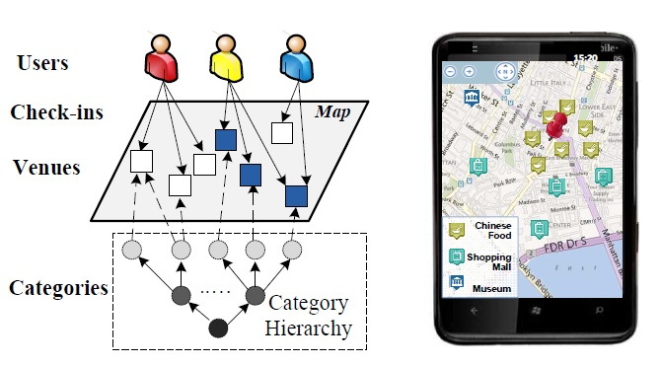
Location-aware recommendation systems
Generally, they appear in mobile phone applications, based on the current location of the user, they give her suggestions in a certain area.
When the offer is given to the user, his geographic information is also involved in the process of providing the offer

Slide 15
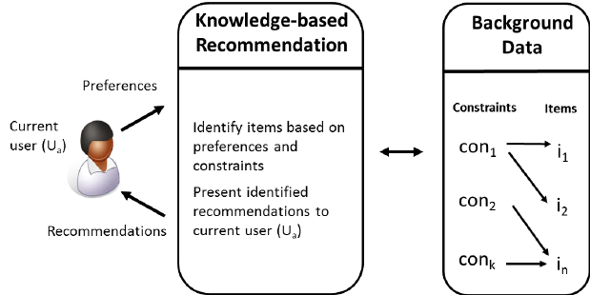
Knowledge-based Filtering
Based on existing knowledge about users and items
They provide their suggestions based on their interpretation and inference of the user's tastes and needs
The need for a knowledge-based platform and structure
Constraint-based reasoning
Case-based reasoning
Social knowledge
Vectors knowledge
Some models in this field:
Based on users-roles-tasks model (Each of the users perform what roles and what tasks)
Based on peer-to-peer model(System knowledge about items and users is distributed among peers)

Slide 16

Bio-inspired Algorithm
Evolutionary algorithm solutions (Genetic Algorithms)
Clustering models
Users are classified into groups so that similar users are placed in the same groups
Suggestions should be given to the group instead of the individual, thus reducing the time and overhead of calculations
Hybrid user models
Generally, a combination of Collaborative Filtering with methods such as Demographic Filtering or Content-based Filtering
Genetic algorithm chromosomes can be used as Demographic Information of users
2) Neural network solutions (NN)
They are formed based on the function and behavior of the body’s neural system, which provide the power of learning based on previous inputs and patterns for recommender systems.

Slide 17
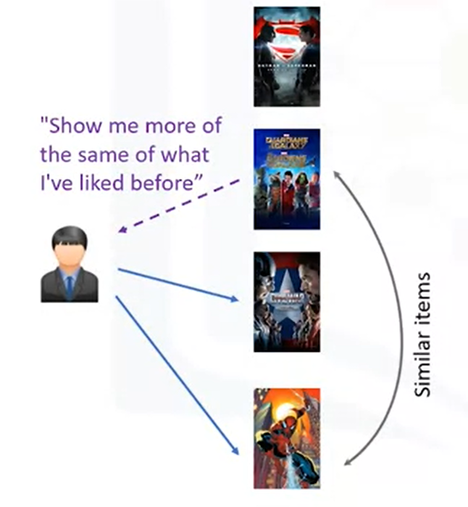
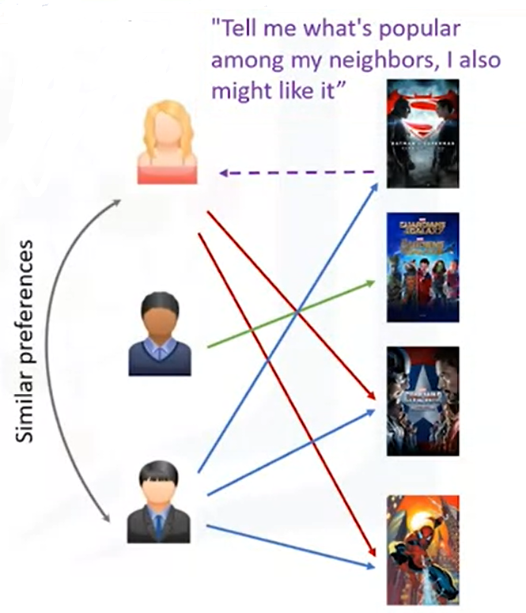
Two main types of recommender systems
Content-Based
Collaborative Filtering

Slide 18
Approaches of implementing recommender systems

Slide 19
Implementing recommender systems
Memory-based
Uses the entire user-item dataset to generate a recommendation
Uses statistical techniques to approximate users and items
e.g., Pearson Correlation, Cosine Similarity, Euclidean Distance, etc.
Model-based
Develops a model of users in an attempt to learn their preferences
Models can be created using Machine Learning techniques like regression, clustering, classification, etc.

Slide 20
Content-based recommendation systems

Slide 21
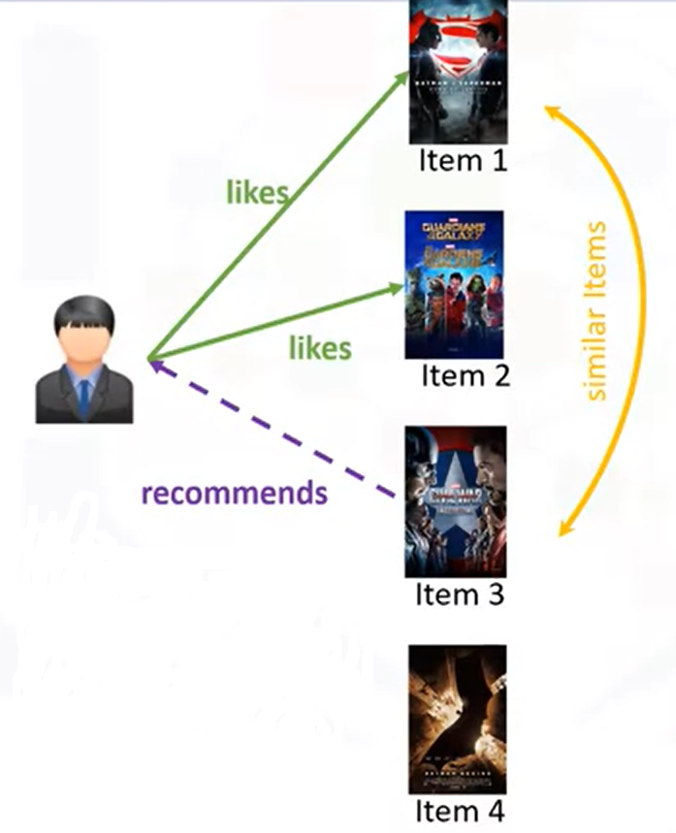
Content-based recommendation systems
Items content: Items category, Tag, Genre, etc.
For example: If we have four movies, and if the user likes or rates the first two items, and if Item 3 is similar to Item 1 in terms of their genre, the engine will also recommend Item 3 to the user.

Slide 22
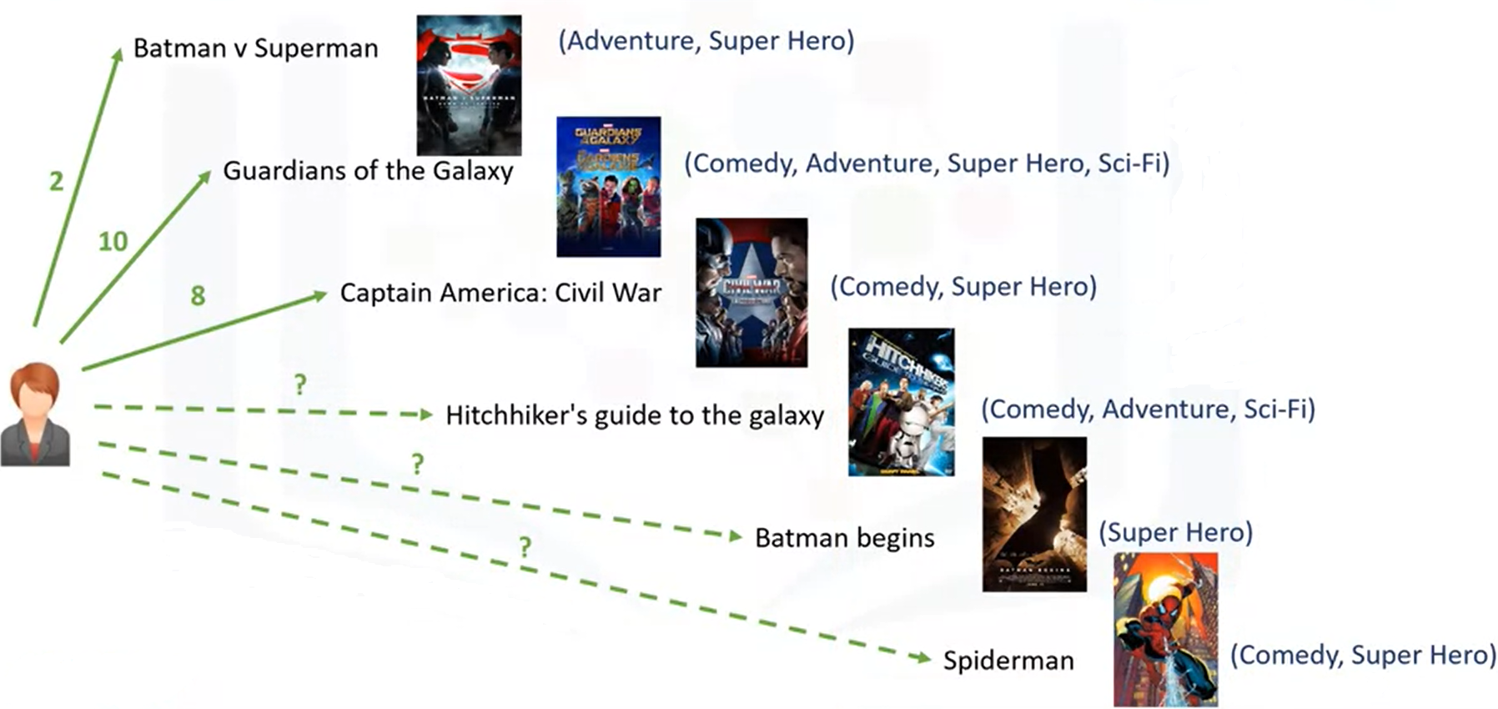
How the engine of content-based recommender systems work?
User watched & rated 3 movies:
Batman v Superman (2/10)
Guardians of the Galaxy (10/10)
Captain America: Civil War (8/10)
Based on:
User’s taste
The content/feature set items
Task:
Recommend one of the three candidate movies to this user (we want to predict what the user's possible rating would be of the three candidate movies if she were to watch them)

Slide 23



Weighing the genres
Input User Rating
Movies Matrix
Comedy | Adventure | Super-Hero | Sci-Fi
0 | 1 | 1 | 0
1 | 1 | 1 | 1
1 | 0 | 1 | 0
2
One-hot encode
10
8

Slide 24
Weighing the genres
Input User Rating * Movies Matrix = Weighted Genre Matrix
Comedy | Adventure | Super-Hero | Sci-Fi
0 | 2 | 2 | 0
10 | 10 | 10 | 10
8 | 0 | 8 | 0

Slide 25
Making user profile
Sum comedy weights = 0 + 10 + 8 = 18
Sum adventure weights = 2 + 10 + 0 = 12
Sum super-hero weights = 2 + 10 + 8 = 20
Sum Sci-Fi weights = 0 + 10 + 0 = 10
Total weights = 18 + 12 + 20 + 10 = 60
Normalize the weights:
Comedy: 18 / 60 = 0.3
Adventure: 12 / 60 = 0.2
Super-hero: 20 / 60 = 0.33
Sci-Fi: 10 / 60 = 0.16
User Profile
Comedy | Adventure | Super Hero | Sci-Fi
0.3 | 0.2 | 0.33 | 0.16

Slide 26



Finding a recommendation
User Profile
Comedy | Adventure | Super-Hero | Sci-Fi
0.3 | 0.2 | 0.33 | 0.16
Mul
Weighted Movies Matrix
Comedy | Adventure | Super-Hero | Sci-Fi
1 | 1 | 0 | 1
0 | 0 | 1 | 0
1 | 0 | 1 | 0
Comedy | Adventure | Super-Hero | Sci-Fi
0.3 | 0.2 | 0 | 0.16
0 | 0 | 0.33 | 0
0.3 | 0 | 0.33 | 0
Movies Matrix

Slide 27
Recommendation Matrix
Weighted Average
0.3+0.2+0+0.16 = 0.66
0+0+0.33+0=0.33
0.3+0+0.33+0=0.63
Weighted Average
0.66
0.63
0.33
Sort & Recommend
Never recommend any movie within other genres

Slide 28
Challenges of content-based filtering
The difficulty of extracting data and information about items and users
In some applications(such as music, video weblogs), finding similarities between different items based on their attributes and contents is very complicated and difficult
The need for solutions to extract pages automatically
Overspecialization problem
Items that may be liked by the user, but are not similar to the items selected in the past, will never be offered to the user and will remain hidden from her view
Inability to get user feedback
In such systems, users usually do not rate the items, which makes it impossible to find out whether the offer given to the user was correct.

Slide 29
Collaborative filtering recommendation systems

Slide 30
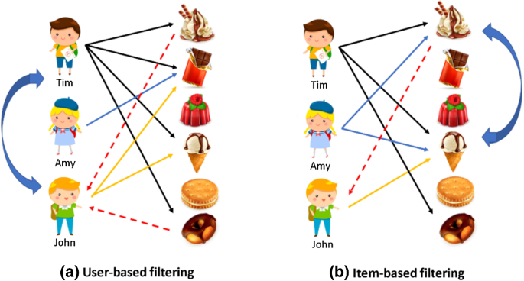
Collaborative filtering recommendation systems
Based on : Relationships exist between products & people’s interests
Two approaches:
User-based collaborative filtering
Based on user’s similarities/ user’s neighborhood
Item-based collaborative filtering
Based on item’s similarity

Slide 31
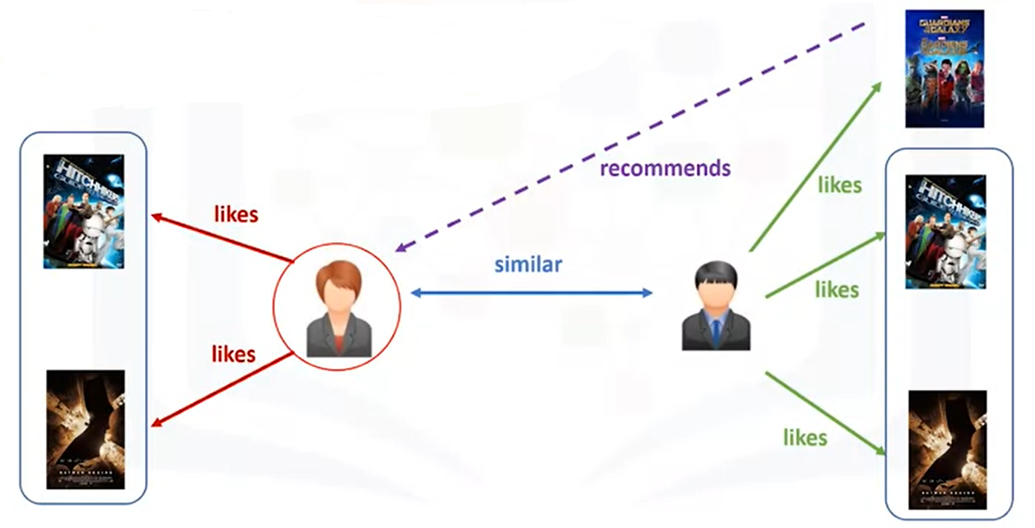
User-based collaborative filtering
Similarity on things like:
History
Preference
Choices
Active user: User for whom the recommendation is aimed
** E.g., movies that similar users have rated highly

Slide 32




User ratings matrix
Find out which of the two movies that
our active user hasn't watched should be recommended to her.
These two movies are:
Batman v Superman
Batman begins
9 | 6 | 8 | 4
2 | 10 | 6 |  | 8
5 | 9 |  | 10 | 7
? | 10 | 7 | 8 | ?
Active User

Slide 33
Similarity weights
Several statistical & vectorial techniques (distance & similarity measurements)
Euclidean Distance
Pearson Correlation
Cosine Similarity
…
Level of similarity between two users:
Use movies that both of users have rated in the past
9 | 6 | 8 | 4
2 | 10 | 6 |  | 8
5 | 9 |  | 10 | 7
? | 10 | 7 | 8 | ?
0.4
0.9
0.7
Rating Matrix

Slide 34
Creating the weighted ratings matrix
Similarity Index
0.4
0.9
0.7
9
2 | 8
5 | 7
3.6
1.8 | 7.2
3.5 | 4.9
Ratings Matrix Subset
Similarity Matrix
Weighted Ratings Matrix
Weighted Ratings Matrix:
Represents the user’s neighbors opinion about are two candidate movies for recommendation.

Slide 35
Recommendation matrix
Similarity Index
0.4
0.9
0.7
Weight Sum
0.9+0.7=1.6
0.4+0.9+0.7=2.0
 | 7.2+4.9= 12.1
3.6+1.8+3.5=8.9
Div
Rating & Weight Matrix
8.9/2.0=4.45 | 12.1/1.6=7.56
Similarity7.56
Sort & Recommend
Recommendation Matrix

Slide 36
KNN(K-Nearest-Neighbors) Algorithm
The most common algorithm used in the Collaborative filtering method
Advantages: Simplicity & Accuracy
Disadvantages: Scalability & Sparsity
3 Steps of algorithms that implement based on user-to-user:
Based on a similarity measurement, a number of k neighbors are selected for user a. These neighbors are the ones that are most similar to user a.
All items in the system are calculated as a quantitative measure to predict whether item i will be liked by user a or not. (Using different solutions like average, weighted sum, …)
Among all the items, N items that have more than the predicted value are suggested to the user.
3 Steps of algorithms that implement based on item-to-item:
Based on a similarity measurement, we determine the number of neighbors q for each item i.
If user a has not rated item i so far, we calculate the prediction value based on the ratings this user has given to neighboring items i.
Based on the values of predictions, we suggest the items that have the highest value of prediction to user a.

Slide 37
Challenges of collaborative filtering
Data Sparsity
Users in general rate only a limited number of items
Cold Start
Difficulty in recommendation to new users or new items
User profile doesn’t exist for users
Items which has not received a rating
Scalability
Increase in number of users or items (drop in performance)
Expands amount of data
Use hybrid-based recommendation systems

Slide 38
Evaluation of recommender systems

Slide 39
Evaluation of recommender systems
Online method (A/b Test):
Ideal for evaluation
User interactions are measured when system recommender suggestions are given to the user
Difficult to implement this way of working ( the only way to implement interaction testing is with the system that is currently in production )
Using real customers for tests in recommender systems is much slower than if the data is already available
2) Offline method:
Ideal for experimental
The user is not directly involved
The system does not need to be deployed to be evaluated
Part of the data will be used to build the system(Train) and the other part will be used to evaluate it(Validation)

Slide 40
Implementation of the recommender system

Slide 41
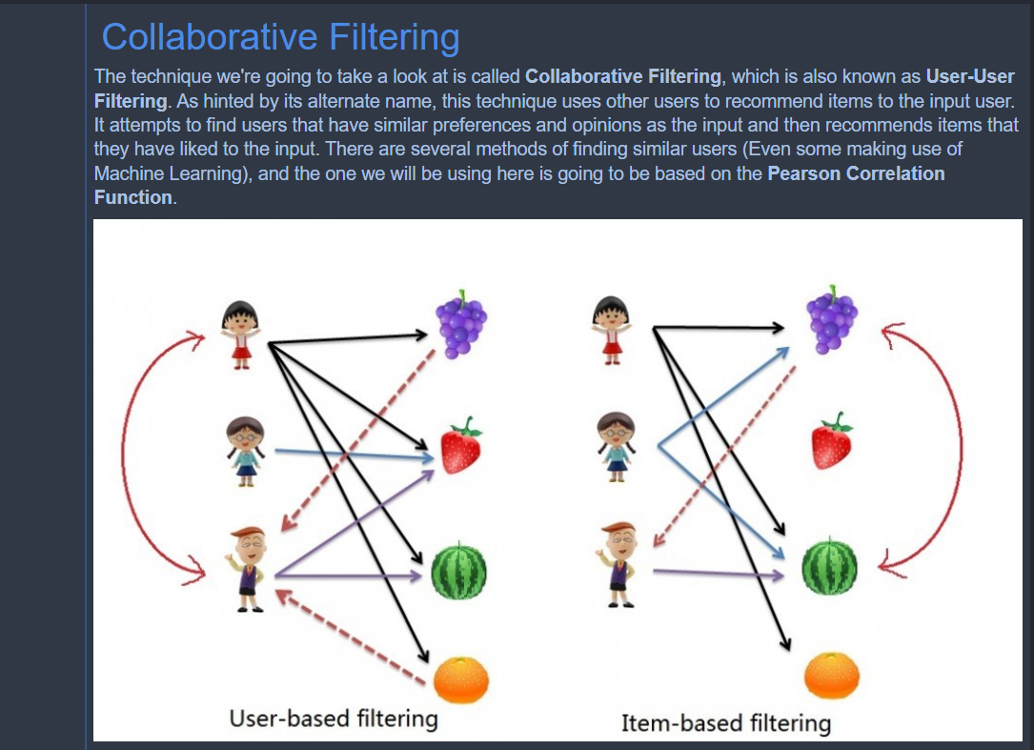
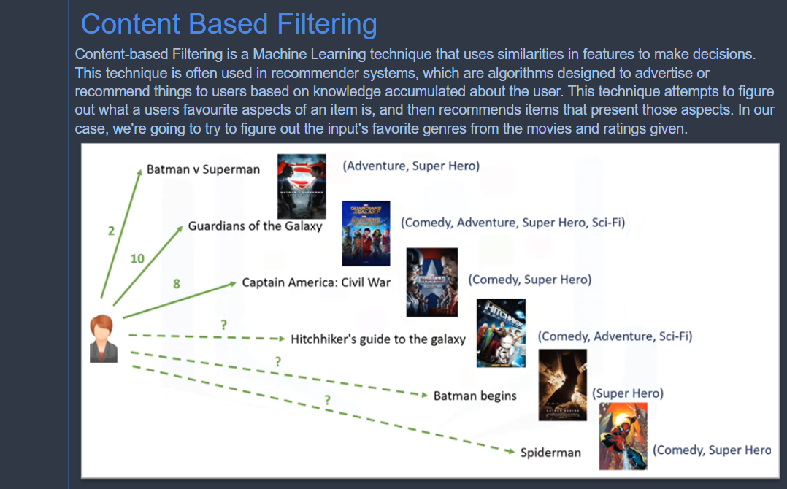
Implementation of the recommender systems in Python

Slide 42
Thank you For Your Attention

